Slide 1
Programming for Data Analytics
Version Control (with Git)
Sam Weiss
sweiss@cct.ie

Slide 2
Version Control Systems
These are a kind of systems that keep record of changes that occur in a given set of files.
Of course, in computer science we use it to keep track on source code of computer programs.
Examples:
Git – The one we’ll use
Subversion
Mercurial

Slide 3
Git
Originally made by Linus Torvalds in 2005 to help the development of the Linux kernel.
Free and open source.
Runs on local machine.
Fully fledged repository:
Complete history
Full version tracking

Slide 4
Capabilities of Git
Keeps record of changes that have been applied to a file or a set of files
Adds some metadata to the records: such as who made the changes, date, time, description messages etc..
Allows to create parallel copies of the code, so you can apply changes without compromising working parts of previous versions
Enables very dynamic team collaboration – Very relevant in industry

Slide 5
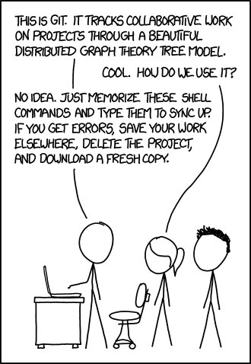
https://xkcd.com/1597/

Slide 6
How does it work?
Git uses a Graph Theory Tree Model
More detail at: https://www.youtube.com/watch?v=2sjqTHE0zok
Tracks changes as a series of snapshot and each one is linked to the previous snapshot

Slide 7
How does it work?
You probably are familiar with a tree structure.
A root directory contains some files or other directories and this can happen recursively several times.
This could be considered one of the snapshots from the previous slide.
So, if some of the files/directories change, we can take a new snapshot to add it to the record.

Slide 8
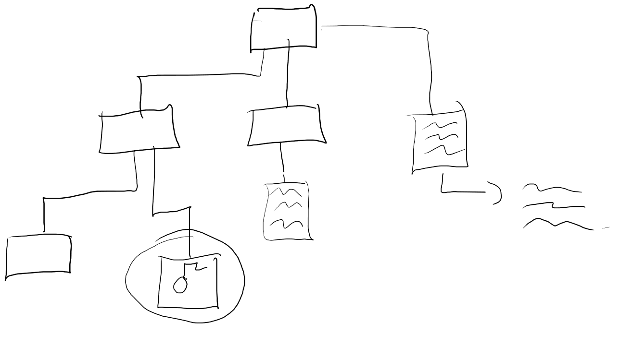
How does it work?

Slide 9
GitHub
Cloud hosting service for collaborative version control that uses Git.
In other words, when we create a Git repository in our machine, we can create a “cloud” version of it and host it on GitHub.
Allows us to have a back up of our full source code, and full change history up on the internet
Works as centralised repository for team collaboration
Catalogue of code for your CV
Repository to access code that is written under open source policies

Slide 10
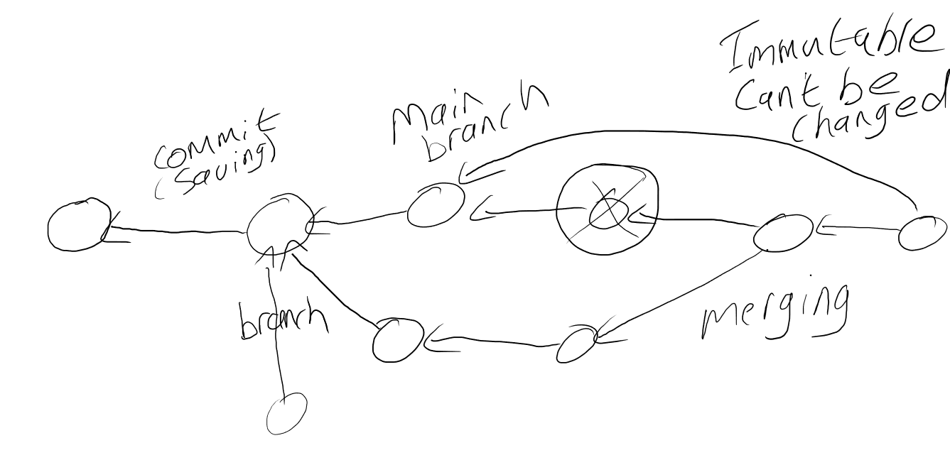
How does GitHub work?

Slide 11
What we need...
GitHub account
https://github.com/
GitHub Desktop (download and install)
https://desktop.github.com/
Some code (or files) to track using Git
We’ll create a project on NetBeans

Slide 12
Disclaimer
In industry there is a strong presence of Git repositories using the command line interface!
My recommendation is to start with GitHub Desktop that works well, and then make sure that you become familiar with the CLI commands

Slide 13
Let’s try it out!
Keep in mind that Git is a very powerful tool so it’s impossible to cover all details of its functionality. Hopefully the most important basics will be covered, but don’t be afraid to look for external sources to expand on the topic.

